Slide 1
OOAD and UML
Phaniraj

Slide 2
About Myself
PHANI RAJ B.N.
Over 20 years of experience in the IT Industry
Done projects on DotNET, Java, and PHP
Has done trainings for over 100 companies.
Major clients:
Honeywell, Philips, ABB, Sharp Technologies.
Wipro, Mindtree, Infosys, Happiest Minds,
FAI, Starmark, Securiton, Kantar(AQ), Yokagawa.(Recent List).

Slide 3
OOAD
The main purpose of OO analysis is identifying the objects for designing a system.
The analysis can also be done for an existing system.
The analysis can be more efficient if we can identify the objects.
Once we have identified the objects, their relationships are then identified, and the design is also produced.

Slide 4
The purpose
The purpose of OO is given below:
To identify the objects of a system.
To identify their relationships.
To make a design that is executable when the concepts of OO are employed.

Slide 5
History
The first object–oriented language was Simula (Simulation of real systems) that was developed in 1960 by researchers at the Norwegian Computing Center.
In 1970, Alan Kay and his research group at Xerox PARK created a personal computer named Dynabook and the first pure object-oriented programming language (OOPL) - Smalltalk, for programming the Dynabook.
In the 1980s, Grady Booch published a paper titled Object Oriented Design that mainly presented a design for the programming language, Ada. In the ensuing editions, he extended his ideas to a complete object–oriented design method.
In the 1990s, Coad incorporated behavioral ideas to object-oriented methods.
Notes:
The object-oriented paradigm took its shape from the initial concept of a new programming approach, while the interest in design and analysis methods came much later.

Slide 6
What is Object-oriented analysis
Object–Oriented Analysis (OOA) is the procedure of identifying software engineering requirements and developing software specifications in terms of a software system’s object model, which comprises of interacting objects.
The primary tasks in object-oriented analysis (OOA) are −
Identifying objects
Organizing the objects by creating object model diagram
Defining the internals of the objects, or object attributes
Defining the behavior of the objects, i.e., object actions
Describing how the objects interact
Notes:
The main difference between object-oriented analysis and other forms of analysis is that in an object-oriented approach, requirements are organized around objects, which integrate both data and functions.
They are modeled after real-world objects that the system interacts with. In traditional analysis methodologies, the two aspects - functions and data - are considered separately.

Slide 7
Object-oriented programming
Object-oriented programming (OOP) is a programming paradigm based upon objects (having both data and methods) that aims to incorporate the advantages of modularity and reusability.
Objects, which are usually instances of classes, are used to interact with one another to design applications and computer programs.
Examples of object-oriented programming languages are C++, Java, Smalltalk, Delphi, C#, Perl, Python, Ruby, and PHP.

Slide 8
Features of OOP
Bottom–up approach in program design
Programs organized around objects, grouped in classes
Focus on data with methods to operate upon the object’s data
Interaction between objects through functions
Reusability of design through the creation of new classes by adding features to existing classes

Slide 9
Object Model
The object model visualizes the elements in a software application in terms of objects.
An object is a real-world element in an object–oriented environment that may have a physical or a conceptual existence.
Each object has −
Identity that distinguishes it from other objects in the system.
State that determines the characteristic properties of an object as well as the values of the properties that the object holds.
Behavior that represents externally visible activities performed by an object in terms of changes in its state.
Notes:
Objects can be modelled according to the needs of the application. An object may have a physical existence, like a customer, a car, etc.; or an intangible conceptual existence, like a project, a process, etc.

Slide 10
Class
A class represents a collection of objects having the same characteristic properties that exhibit common behavior.
It gives the blueprint or description of the objects that can be created from it.
Creation of an object as a member of a class is called instantiation.
Similar to variables of a data type, class variables are called as objects.
Notes:
The constituents of a class are −
A set of attributes for the objects that are to be instantiated from the class. Generally, different objects of a class have some difference in the values of the attributes. Attributes are often referred as class data.
A set of operations that portray the behavior of the objects of the class. Operations are also referred as functions or methods.

Slide 11
Encapsulation and data hiding
Encapsulation is the process of binding both attributes and methods together within a class.
Through encapsulation, the internal details of a class can be hidden from outside.
It permits the elements of the class to be accessed from outside only through the interface provided by the class.
A class is designed such that its data (attributes) can be accessed only by its class methods and insulated from direct outside access.
This process of insulating an object’s data is called data hiding or information hiding.

Slide 12
Message passing
Many a time, information or data has to be shared among the objects.
Objects in a system may communicate with each other using message passing.
Message passing between two objects is generally unidirectional.
Message passing enables all interactions between objects.
Message passing essentially involves invoking class methods.
Objects in different processes can be involved in message passing.

Slide 13
Inheritance
Inheritance is the mechanism that permits new classes to be created out of existing classes by extending and refining its capabilities.
The existing classes are called the base classes/parent classes/super-classes, and the new classes are called the derived classes/child classes/subclasses.
The subclass can inherit or derive the attributes and methods of the super-class(es) provided that the super-class allows so.
Besides, the subclass may add its own attributes and methods and may modify any of the super-class methods. Inheritance defines an “is – a” relationship.

Slide 14
Types of inheritance
Single Inheritance − A subclass derives from a single super-class.
Multiple Inheritance − A subclass derives from more than one super-classes.
Multilevel Inheritance − A subclass derives from a super-class which in turn is derived from another class and so on.
Hierarchical Inheritance − A class has a number of subclasses each of which may have subsequent subclasses, continuing for a number of levels, so as to form a tree structure.
Hybrid Inheritance − A combination of multiple and multilevel inheritance so as to form a lattice structure.

Slide 15
Polymorphism
Means the ability to take multiple forms.
Polymorphism implies using operations in different ways, depending upon the instance they are operating upon.
Polymorphism allows objects with different internal structures to have a common external interface. Polymorphism is particularly effective while implementing inheritance.

Slide 16
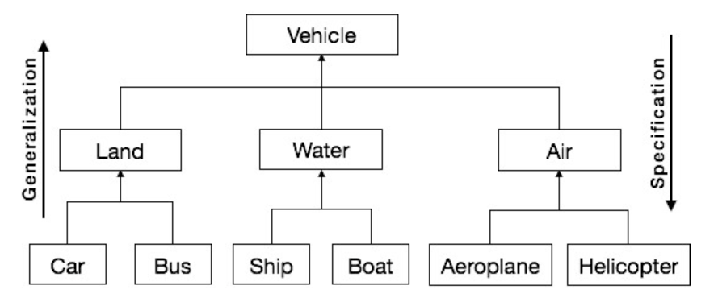
Generalization and specialization
In the generalization process, the common characteristics of classes are combined to form a class in a higher level of the hierarchy, i.e., subclasses are combined to form a generalized super-class. It represents an “is – a – kind – of” relationship.
Specialization is the reverse process of generalization.
The distinguishing features of groups of objects are used to form specialized classes from existing classes.
It can be said that the subclasses are the specialized versions of the super-class.

Slide 17
association
Association depicts the relationship between objects of one or more classes.
One–to–One − A single object of class A is associated with a single object of class B.
One–to–Many − A single object of class A is associated with many objects of class B.
Many–to–Many − An object of class A may be associated with many objects of class B and conversely an object of class B may be associated with many objects of class A.

Slide 18
Composition or aggregation
Aggregation or composition is a relationship among classes by which a class can be made up of any combination of objects of other classes.
It allows objects to be placed directly within the body of other classes. Aggregation is referred to as a “part–of” or “has–a” relationship, with the ability to navigate from the whole to its parts.
An aggregate object is an object that is composed of one or more other objects.

Slide 19
Benefits of object model
The benefits of using the object model are −
It helps in faster development of software.
It is easy to maintain. Suppose a module develops an error, then a programmer can fix that particular module, while the other parts of the software are still up and running.
It supports relatively hassle-free upgrades.
It enables reuse of objects, designs, and functions.
It reduces development risks, particularly in integration of complex systems

